Slide 1

Design of a 4-Bit Binary
to Decimal Conversion
and Display System
Using Logic Gates
DIGITAL LOGIC DESIGN • FINAL PROJECT
BCD Decoder • 7-Segment Display • Gate-Level Implementation
TEAM MEMBER | ROLL NO.
Akhilesh | [ Roll No. ]
Yashaswini | [ Roll No. ]
Varshita | [ Roll No. ]
Dhanush | [ Roll No. ]
0111
B3 B2 B1 B0 → Decimal 7
Section: [ Section ]
Department of Electronics and Communication Engineering | K.L. University
Notes:
Introduce the project title, the team, and the department. The display on the right shows the idea in one picture: binary input 0111 lights segments a, b, c to show decimal 7.

Slide 2
Why Convert Binary to Decimal?
INTRODUCTION AND OBJECTIVE
INTRODUCTION
OBJECTIVES
Digital systems (computers, counters, sensors) process and store data in binary form.
Humans read decimal.
This project designs a 4-bit binary (BCD) to decimal converter that drives a 7-segment display using only basic logic gates.
1
Bridge the gap
Convert a 4-bit binary code into its decimal digit equivalent (0–9).
2
Build with gates
Implement the conversion using only basic logic gates — AND, OR, NOT.
BINARY
DECIMAL
1001
9
3
Drive a display
Feed the decoded output to a 7-segment display via a BCD-to-7-segment decoder.
Notes:
Purpose: computers work in binary, people read decimal. The project builds the bridge using only AND, OR and NOT gates and displays the result on a 7-segment display.

Slide 3
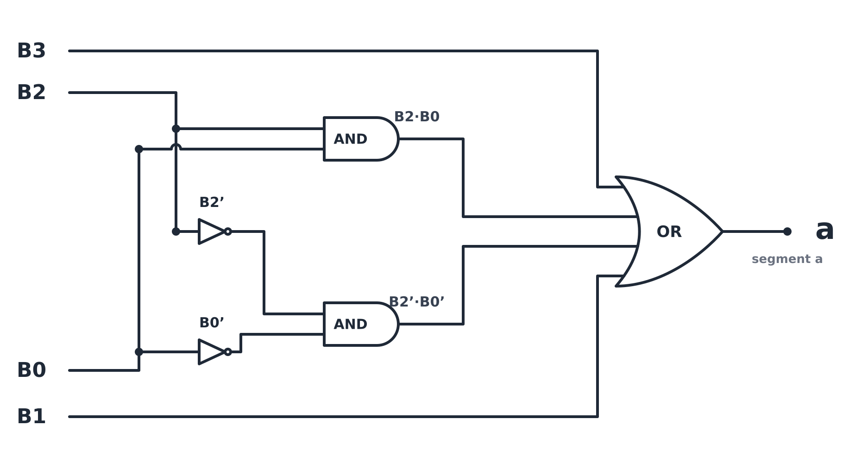
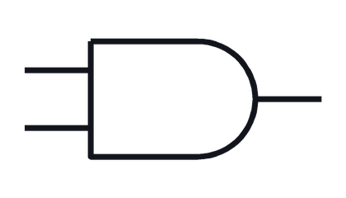

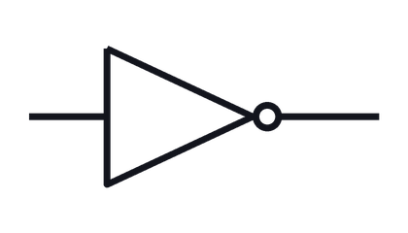
Concept, Logic Gates and Circuit Diagram
THEORY AND LOGIC CIRCUIT
BCD CONCEPT
A 4-bit word B3B2B1B0 gives 16 combinations (0000–1111). In 8421 BCD only 0–9 are valid; the other six (1010–1111) are “don’t-care” states that simplify the logic.
0–9 valid BCD
10–15 don’t-care
LOGIC GATES USED
AND ( · )
output is 1 only when all inputs are 1
OR ( + )
output is 1 when any input is 1
NOT ( ’ )
output is the inverse of the input
Segment a: a = B3 + B1 + (B2·B0) + (B2’·B0’)
Notes:
Segment expressions (checked against the 0-9 truth table; inputs 1010-1111 treated as don't-care):
a = B3 + B1 + B2.B0 + B2'.B0'
b = B2' + B1'.B0' + B1.B0
c = B2 + B1' + B0
d = B3 + B2'.B0' + B1.B0' + B1.B2' + B2.B1'.B0
e = B1.B0' + B2'.B0'
f = B3 + B2.B1' + B2.B0' + B1'.B0'
g = B3 + B2.B1' + B1.B0' + B1.B2'
The same NOT / AND / OR structure is repeated, with different literal combinations, for each of the remaining six segments (b-g).

Slide 4
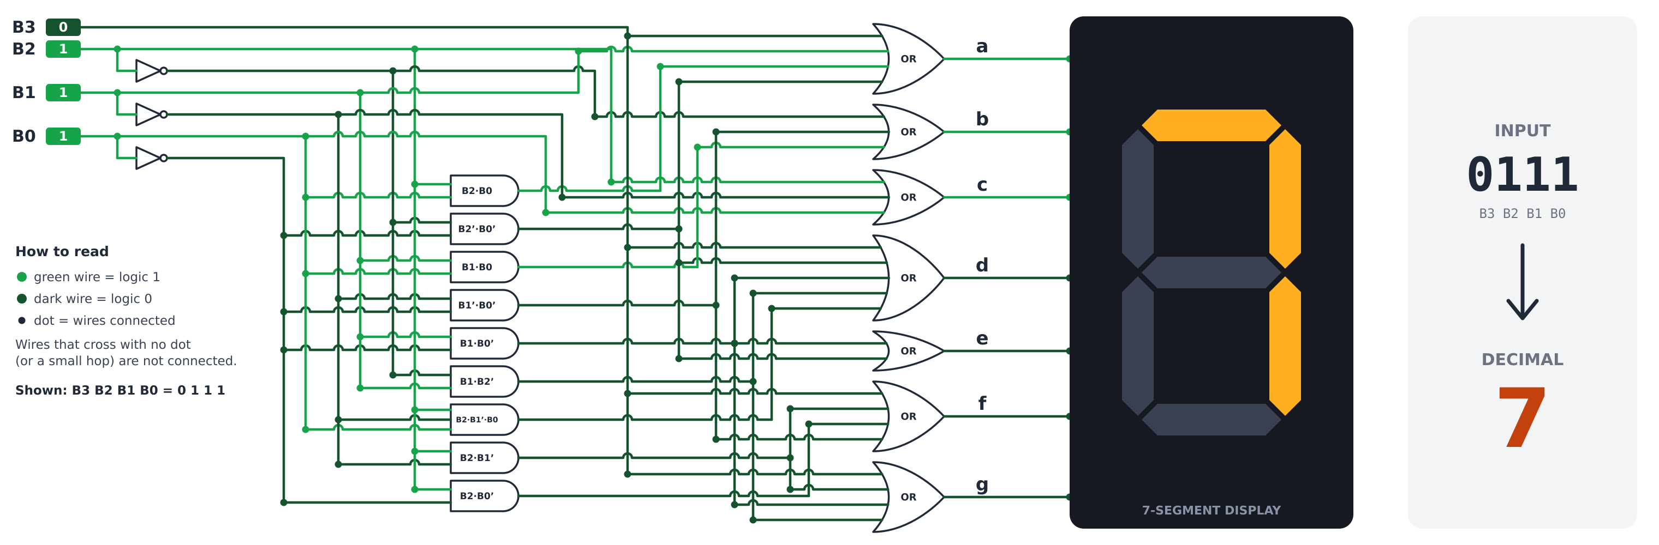
Circuit Implementation and Working
CIRCUIT DESIGN IN LOGISIM
Input pins B3–B0 supply the 4-bit BCD code.
NOT gates generate B2’, B1’ and B0’.
AND gates form product terms; OR gates sum them for each segment.
Outputs a–g drive the 7-segment display (1 = ON).
1
2
3
4
Notes:
Walk through the circuit left to right. The circuit shown is for input 0111: wires in bright green carry logic 1, dark green carry logic 0, and the display shows decimal 7.
Components: input pins, NOT / AND / OR gates, 7-segment display.
Segment expressions (checked against the 0-9 truth table; inputs 1010-1111 treated as don't-care):
a = B3 + B1 + B2.B0 + B2'.B0'
b = B2' + B1'.B0' + B1.B0
c = B2 + B1' + B0
d = B3 + B2'.B0' + B1.B0' + B1.B2' + B2.B1'.B0
e = B1.B0' + B2'.B0'
f = B3 + B2.B1' + B2.B0' + B1'.B0'
g = B3 + B2.B1' + B1.B0' + B1.B2'

Slide 5
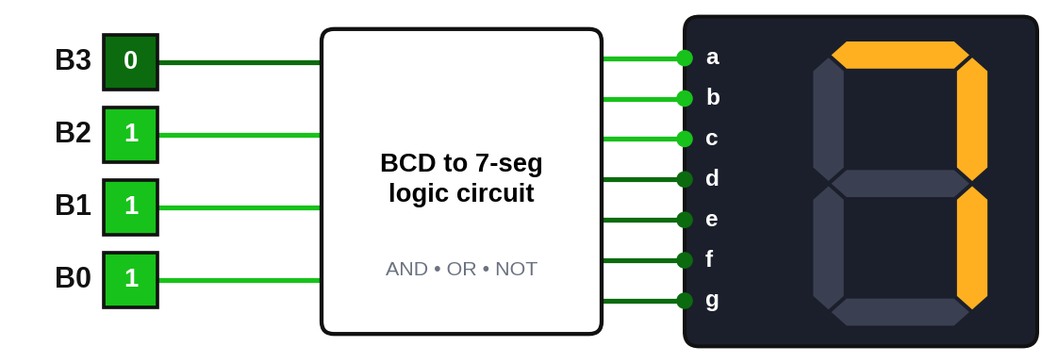
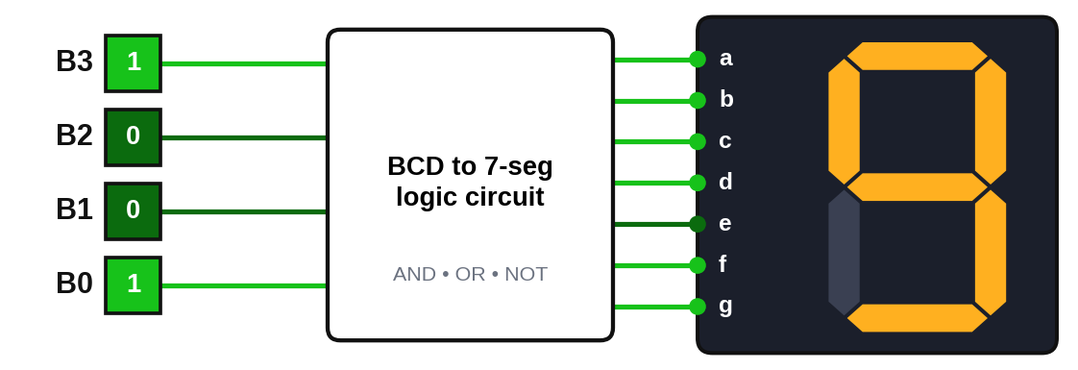
Logisim Simulation and Truth Table
SIMULATION RESULTS
 | INPUT |  |  |  | OUTPUT (SEGMENTS)
Dec | B3 | B2 | B1 | B0 | a | b | c | d | e | f | g
0 | 0 | 0 | 0 | 0 | 1 | 1 | 1 | 1 | 1 | 1 | 0
1 | 0 | 0 | 0 | 1 | 0 | 1 | 1 | 0 | 0 | 0 | 0
2 | 0 | 0 | 1 | 0 | 1 | 1 | 0 | 1 | 1 | 0 | 1
3 | 0 | 0 | 1 | 1 | 1 | 1 | 1 | 1 | 0 | 0 | 1
4 | 0 | 1 | 0 | 0 | 0 | 1 | 1 | 0 | 0 | 1 | 1
5 | 0 | 1 | 0 | 1 | 1 | 0 | 1 | 1 | 0 | 1 | 1
6 | 0 | 1 | 1 | 0 | 1 | 0 | 1 | 1 | 1 | 1 | 1
7 | 0 | 1 | 1 | 1 | 1 | 1 | 1 | 0 | 0 | 0 | 0
8 | 1 | 0 | 0 | 0 | 1 | 1 | 1 | 1 | 1 | 1 | 1
9 | 1 | 0 | 0 | 1 | 1 | 1 | 1 | 1 | 0 | 1 | 1
Input 0111 → Output 7
Input 1001 → Output 9
1 = segment ON, 0 = segment OFF (common-cathode). Highlighted rows match the two simulation outputs. Inputs 1010–1111 are don’t-care.
Notes:
Show each input combination on the simulation and compare with this table. Input 0111 lights segments a, b, c (display 7); input 1001 lights a, b, c, d, f, g (display 9).

Slide 6



A Complete Gate-Level Path
from Binary to Decimal Display
CONCLUSION AND APPLICATIONS
Thank You
OUTCOME
APPLICATIONS
IMPROVEMENTS
A 4-bit binary input is decoded using only basic AND, OR and NOT gates.
K-map simplification with don’t-care conditions minimizes the gates for each segment.
The logic drives a 7-segment display showing decimal digits 0–9.
Digital clocks and timers
Calculators
Digital counters
Measurement instruments
Elevator / floor indicators
Embedded systems
Extend to multi-digit displays using multiplexing.
Add hexadecimal (A–F) support.
Support common-anode displays with inverted outputs.
Implement on an FPGA or microcontroller using HDL.
Notes:
Summarize the outcome, then the applications, then the possible improvements. Close by thanking the audience and inviting questions.

